Slide 1
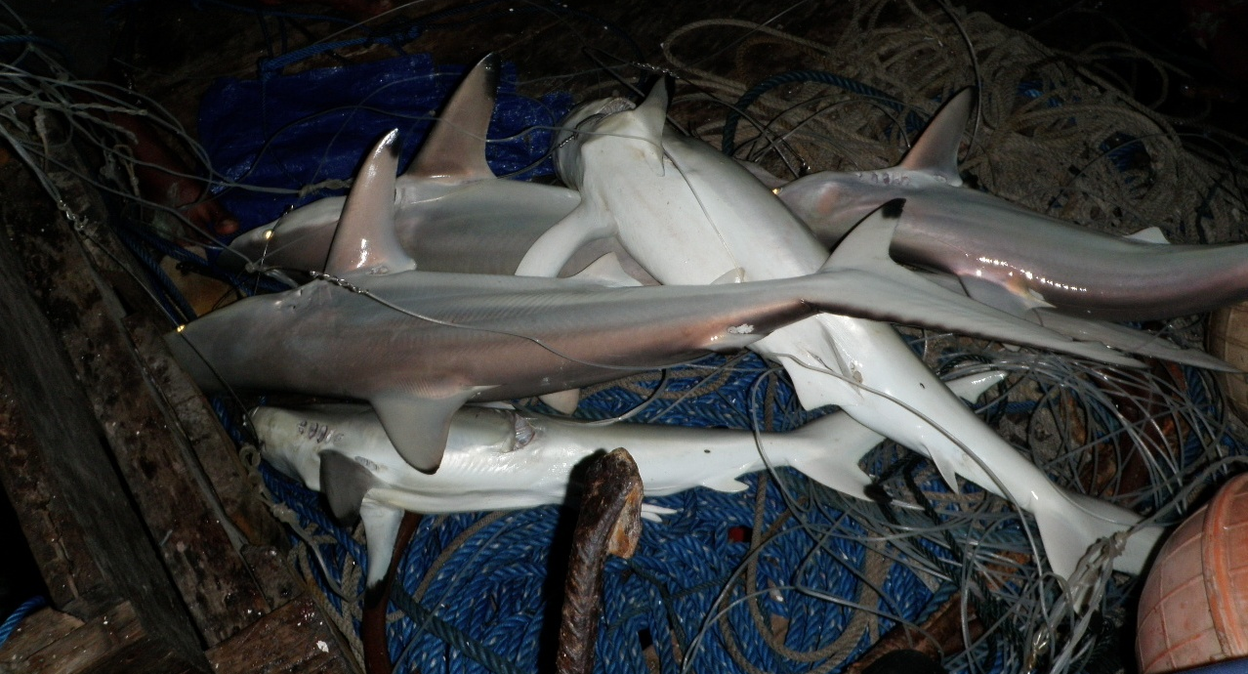
FAO, CITES, fisheries and aquaculture
The importance of fisheries & aquaculture and what we are doing

Slide 2
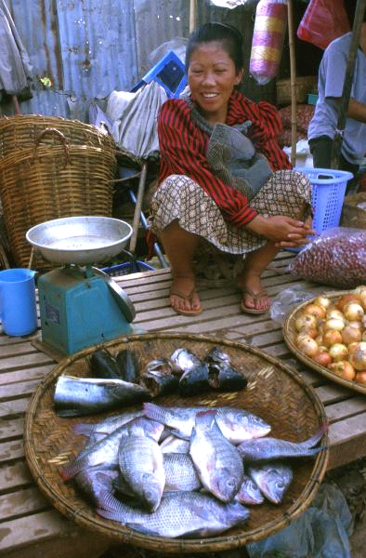
What is at stake?
Over 500 million people depend – directly or indirectly – on fisheries and aquaculture for their livelihoods
Aquatic foods provide essential nutrition for 3 billion people and at least 50% of animal protein and minerals to 400 million people in the poorest countries.
Fish products are among the most widely-traded foods, with more than 37% by volume of world production traded internationally.
2
Notes:
Note the importance of international trade – raises potential importance of CITES

Slide 3
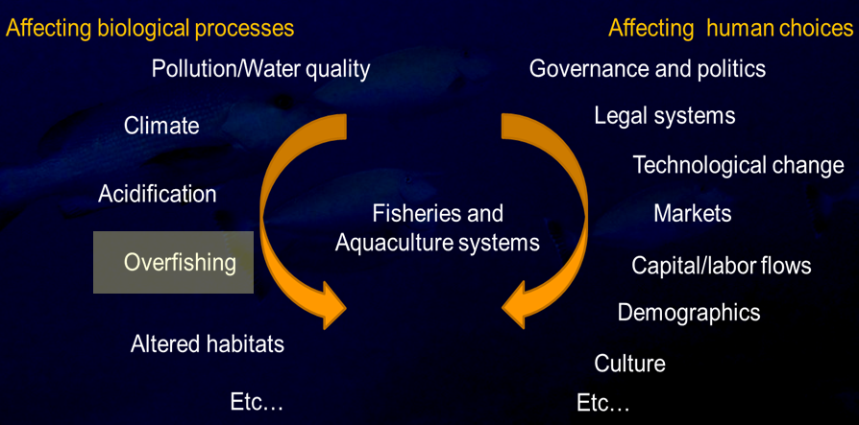
Drivers of Change
Notes:
Make the point that of these, Overfishing driven by Markets, including international markets, is the biggest threat to most commercially-exploited aquatic species.

Slide 4
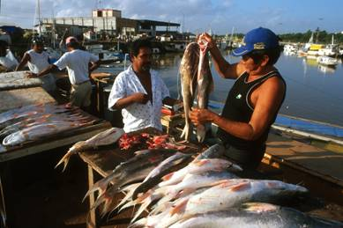
State of World Fisheries & Aquaculture
FAO 2010
Fish trade
Global trade worth
US$ 102 billion
39% exported
Developing countries account for 55% world fish exports
China biggest exporter valued over US$ 10 billion
Notes:
There has been a dramatic growth in international trade in value terms which reached a record 102 billion dollars in 2008, nearly doubling in ten years.
Further strong growth is expected, despite slowed trading from the current global economic crisis and food price volatality.
Fish has become among the most highly traded food commodities with nearly 40% of all production now exported -- this has particularly benefited developing countries who now account for 55% of world fish exports destined for human consumption.
China continues to be the world’s largest fish exporter, with a staggering 10 billion US dollars in export value.

Slide 5
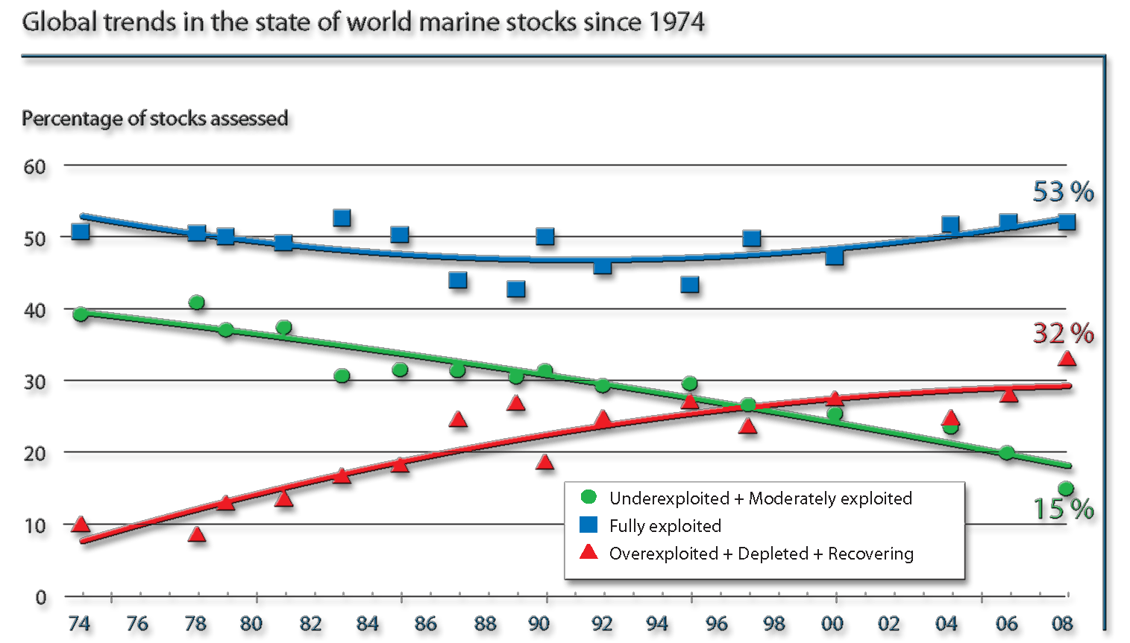
State of World Fisheries & Aquaculture
FAO 2010
Notes:
At present, the overall maximum potential from wild capture fisheries in the oceans has been reached, and further benefits and the sustainability of fisheries can only be achieved through more cautious and effective fisheries management, aimed at maintaining fully exploited fishery resources and recovering those that are overexploited or depleted.
As you can see from this figure:
The overall state of exploitation of the world marine fishery resources has remained relatively stable over the past decade.
The proportion of fully exploited fish stocks (the blue line on the screen) holds steady at about 50 percent.
The proportion of underexploited and moderately exploited stocks (in green) declined from 40% in the mid-1970s to 15% in 2008.
And the proportion of overexploited, depleted and recovering stocks (in red) was at 32% in 2008.

Slide 6


Slide 7
FAO-CITES MoU (2006)
... communicate and exchange information ...
cooperate ... to facilitate capacity building in developing countries ...
FAO ... provide advice to CITES on ... the CITES listing criteria
ensure adequate consultations in the scientific and technical evaluation of proposals ... based on the criteria agreed by the Parties to CITES

Slide 8
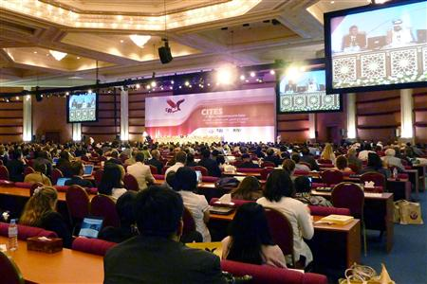
Are countries missing opportunities to use a potentially useful tool for fisheries management because of differences of opinion and polarization?

Slide 9
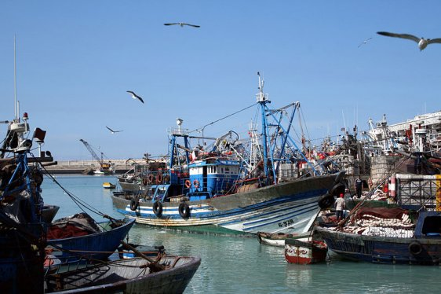
Way forward for effective application of CITES for fisheries
It is essential for national and regional fisheries agencies and CITES authorities to work more closely together, capacity-building in both groups will often be required.

Slide 10
The COFI Sub-Committee on Fish Trade, 2011
“The Sub-Committee ... recognized the role of CITES as a global instrument for the regulation of international trade of species listed in its appendices. Some Members noted that CITES could be an additional trade-related measure to support the conservation of fishery species. Some Members noted that this was particularly the case where fisheries management based on best practices was lacking.”

Slide 11
What CITES Secretariat is doing
Cooperation with FAO
  Bring together CITES authorities and fisheries-related agencies
  Reaching out to RFMOs and RFBs
  Linking to IPOA-sharks (and NPOA)
Regional/national capacity-building
Efforts to ensure that CITES regulations are implemented efficiently and integrated as much as possible into fisheries management regimes
Notes:
Capacity-building: Joint compilation of national/regional needs; development of standard capacity building materials; organization of workshops and meeting sessions

Slide 12
What CITES Secretariat is doing: Regional/national capacity-building
Cooperation between CITES Authorities and fisheries-related agencies
Party-driven capacity needs and work plan towards implementation
  Legality (legal acquisition, national laws)
  Sustainability (stock assessments, NDFs)
  Traceability (identification, reporting, databases)
Support to activities with direct links to outcome
= improving CITES implementation

Slide 13







Thank you for your attention!
CITES and FAO working for legal, sustainable and traceable international trade in sharks and manta rays, supported by the European Union

