Slide 1
CITES: an introduction

Slide 2


Convention on International Trade in Endangered Species of
Wild Fauna and Flora
Washington, D.C., on 3 March 1973
Notes:
Convention on International Trade in Endangered Species of Wild Fauna and Flora, known as CITES or the Washington Convention
CITES was signed on 3 March 1973, and entered into force on 1 July 1975.
CITES has been in operation for 40 years

Slide 3
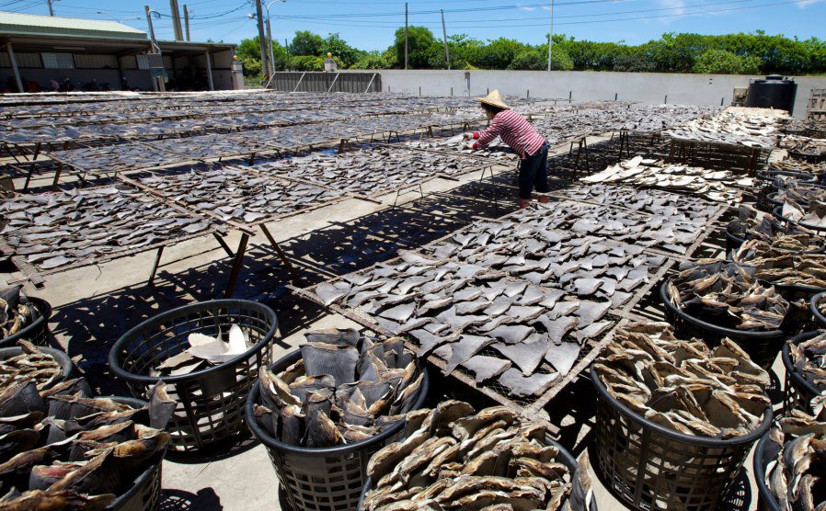
CITES objectives
Ensure that wild fauna and flora in international trade are not exploited unsustainably
Legality, sustainability, traceability
S. Heindrichs / PEW, Shark fins, China
Notes:
The objective of CITES is to ensure that wild fauna and flora in international trade are not exploited unsustainably, through making sure of their legality, sustainability, and traceability.

Slide 4
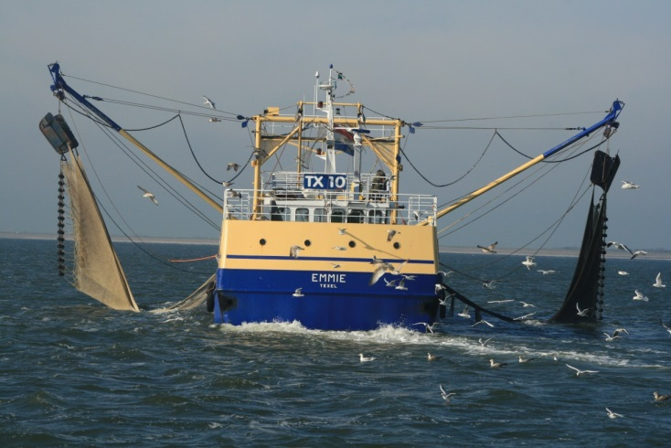
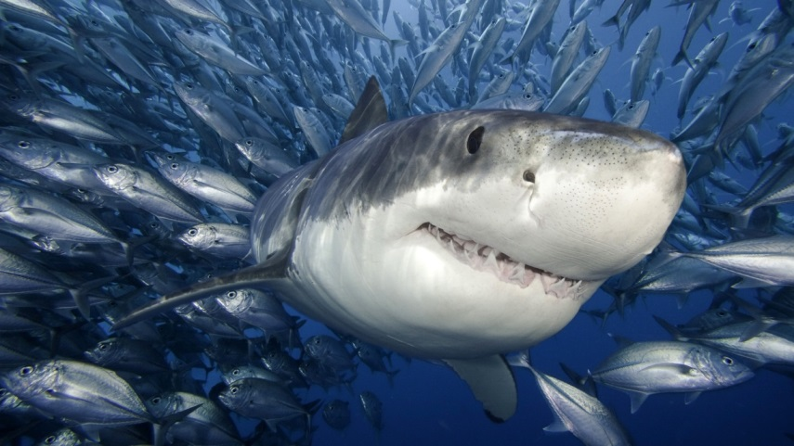
CITES is a multilateral agreement
Operates through an intergovernmental process,
which combines wildlife and trade themes within a legally binding instrument,
achieving conservation
and sustainable use objectives
…by setting a common procedural mechanism
Notes:
CITES is a multilateral agreement that operates through an intergovernmental process, which combines wildlife and trade themes within a legally binding instrument, working towards achieving conservation and sustainable use objectives by setting common procedural mechanisms.
CITES mechanisms that are common to all Parties include:
Similar national authorities in charge of CITES
Similar legal provisions for implementing CITES at national level
Similar requirements for trade in CITES species to take place
Similar rules, regulations and procedures
Similar CITES permits and certificates

Slide 5
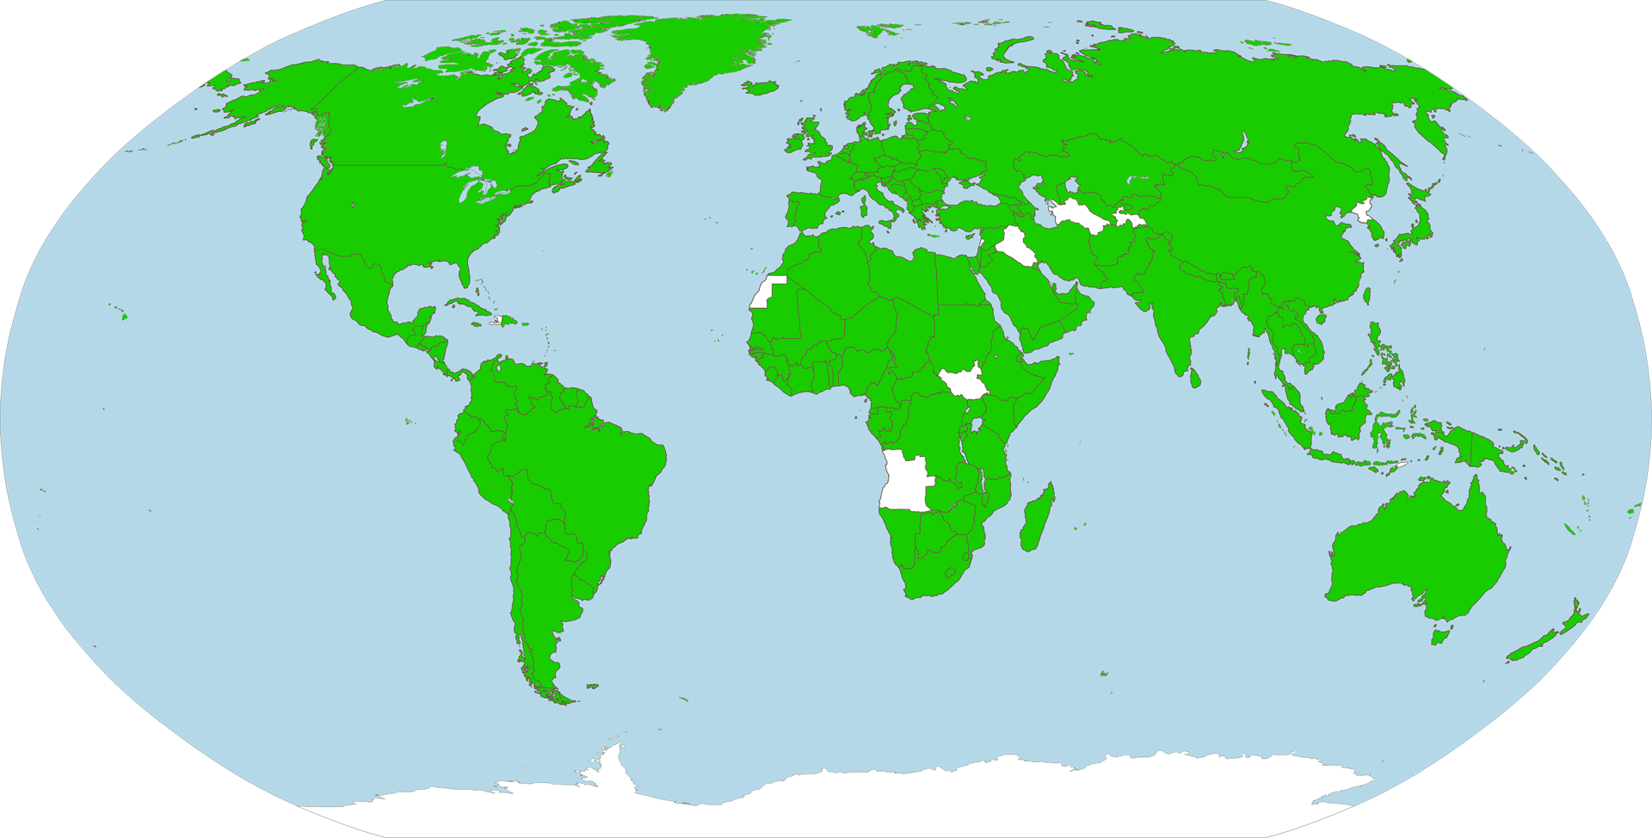
CITES coverage & scope
180 member countries
Regulates international trade of 35,000+ listed species (live, dead, parts and derivatives)
www. cites.org
Notes:
CITES currently has 179 member countries. The latest Party to join the Convention is Angola, where the Convention will enter into force on 31 December 2013.
CITES regulates international trade of 35,000+ listed species. This concerns live or dead specimens, as well as their parts and derivatives.

Slide 6
Not all species are prohibited from trade…
Of the 35,000+ listed species…
3% Appendix I
(international commercial trade in wild specimens prohibited)
97% Appendix II&III (regulated)
Notes:
Not all species covered by CITES are prohibited from international trade. In fact, of the more than 35,000 species listed under CITES, only 3% are in Appendix I, for which international commercial trade in wild specimens is prohibited. 97% are in Appendix II or III, for which international commercial trade is permitted but regulated.

Slide 7
Not all listed species appear in trade…
Of the 35,000+ listed species...
4% commonly traded
1% highly traded
About 150 animal and 1,800 plant species account for 90% of CITES transactions
Notes:
Of those species for which international commercial trade is permitted but regulated, not all are heavily traded, either.
A recent analysis of the CITES trade records shows that of the more than 35,000 species covered by CITES, 4% are commonly traded, and an additional 1% can be considered as highly traded. That is equivalent to about 150 animal and 1,800 plant species, which account for 90% of the recorded trade in CITES specimens.

Slide 8

Wildlife Trade & Economy

Slide 9
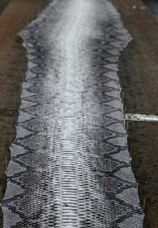
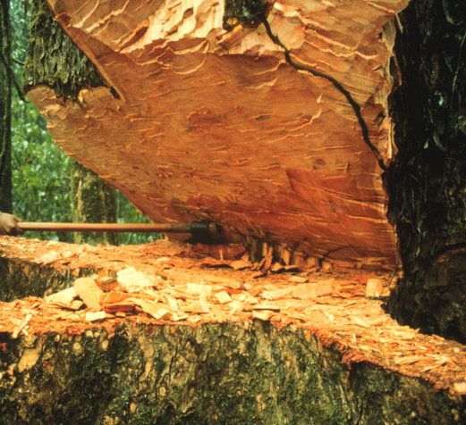
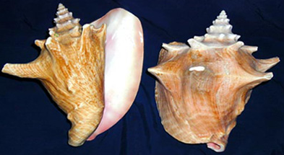
Value of CITES trade
Record of 13 million trade transactions
Globally valued in billions of US Dollars
  Examples:
  Queen conch: $ 60 MM/year
  Python skins = $ 1 BN/year
  Bigleaf mahogany = $ 33 MM/year
www. cites.org
Notes:
In terms of the volume of the trade in CITES-listed species, the CITES Secretariat currently has records of over 13 million trade transactions. The global value of this trade is estimated to amount to several of billions of dollars per year at the end of the supply chain.
For example, trade in queen conch, valued for its meat as well as its ornamental shell, is said to be worth 60 million US dollars per year. Pythons, highly valued for their skins in high-end luxury goods, is worth 1 billion US dollars per year, and Bidleaf mahogany, a precious timber species, is worth 33 million US dollars per year.

Slide 10
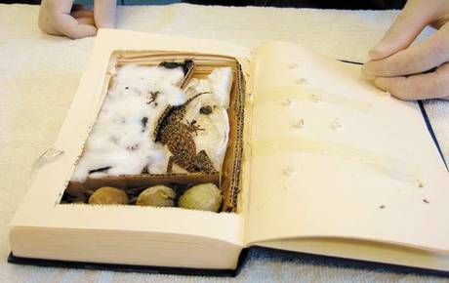
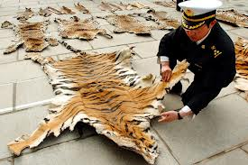
“Value” of illegal trade…
  USD 5-20 billion /year
  (*Estimated, excludes marine & timber)
Specimens that cannot be commercially traded but for which an illegal market exists (tiger skins, rhino horn, etc.)
Specimens that can be lawfully traded, but are not handled in accordance with CITES
Notes:
By virtue of the fact that it is illegal, there is no formal method to estimate the value of illegal trade.
However, it is believed that illegal trade in wildlife is on the increase, and can be a lucrative business – 5 to 20 billion US dollars per year is estimated as the global value. The related incomes and benefits are largely lost to legitimate stakeholders and governments.
Illegal trade can be grouped into two categories: (1) those specimens that cannot be commercially traded but for which an illegal market exist, such as tiger skins, rhino horns, and so on; and (2) those specimens can be lawfully traded, but for which the particular specimen or transaction is not handled in accordance with CITES procedures.

Slide 11

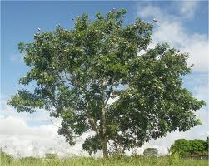




Wildlife trade – economic sectors
Housing & furniture
Mahogany, ramin, cedar, …
Pharmaceuticals
Vaccines, herbal, research,…
Cosmetics
Wax, oils,…
Food
Caviar, fish, wild meat, plants,…
Leather & fashion
Bags, watches, fur, fibers,…
Notes:
Perhaps you might best know CITES for its large mammals – elephants, tigers, and so on. However, wildlife trade regulated by CITES can cut across many different sector
Here are some examples.

Slide 12
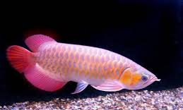
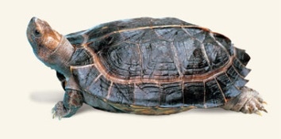

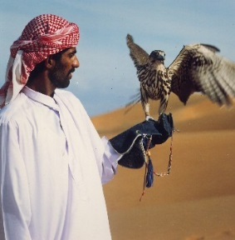
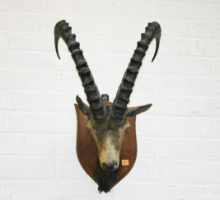
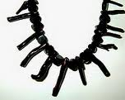


Wildlife trade – economic sectors
Pets
Birds, reptiles, fish…
Tourism
Zoos, museums, botanical gardens, circus
Collections
Hunting safaris, falconry, trophies, souvenirs (shells, corals)
Ornamental plants
Decoration, landscape design, gardens, houseplants, cut flowers

Slide 13
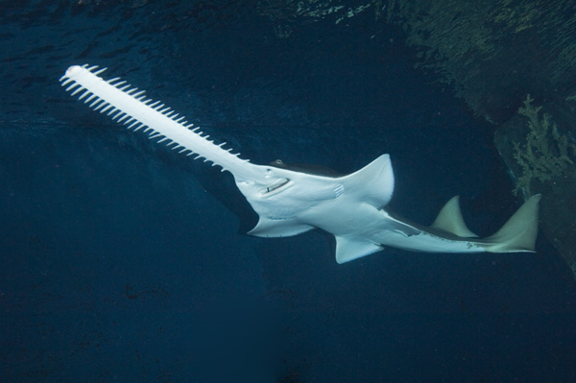
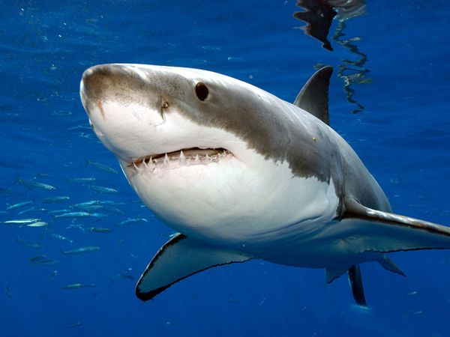
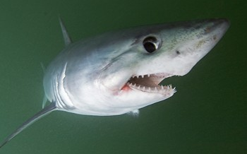
CITES Appendices
Species* regulated under CITES are divided amongst 3 Appendices
I
II
III
* "Species" means any species, subspecies, or geographically separate population thereof”
Notes:
Now, let’s look at how CITES is regulated. Species regulated under CITES are divided amongst 3 Appendices.

Slide 14
CITES Appendix I
Species threatened with extinction, which are or may be affected by trade
International (commercial) trade in wild specimens is generally prohibited
3% of all listings (Conference of the Parties to decide)
Sawfishes: Pristidae spp.
Notes:
CITES Appendix I includes species threatened with extinction, which are or may be affected by trade.
For these species, international commercial trade in wild specimens is generally prohibited. As mentioned earlier, such species constitute 3% of all listings.
In order to add new species to this category or remove a species from Appendix I (either to delete it from the CITES Appendices altogether, or to ‘downlist’ it to Appendix II).
, a decision by the Conference of the Parties to CITES is needed.
An example of marine species listed in CITES Appendix I are the various species of sawfish, the Pristidae.

Slide 15
CITES Appendix II
  Species not necessarily currently threatened with extinction, but may become so unless trade is strictly regulated to avoid utilization incompatible with their survival
  Also, species that resemble species already included in Appendix II
  International (commercial) trade is permitted but regulated
  96% of all listings (Conference of the Parties to decide)
Notes:
CITES Appendix II, on the other hand, include species not necessarily currently threatened with extinction, but that may become so unless trade is strictly regulated to avoid utilization incompatible with their survival.
Appendix II also contains what is called the «look-alike» species, which are species that resemble species already included in Appendix II to such an extent that enforcement officers are unlikely to be able to distinguish them.
For these species, international commercial trade in wild specimens is generally permitted, but regulated through a system of permits and certificates. Such species constitute 96% of all listings.
As for Appendix I, a decision by the Conference of the Parties to CITES is needed in order to add new species to this category, or to remove a species from this category (either to delete it from the CITES Appendices, or to ‘uplist’ it to Appendix I).

Slide 16
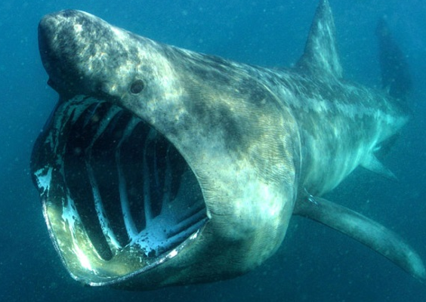
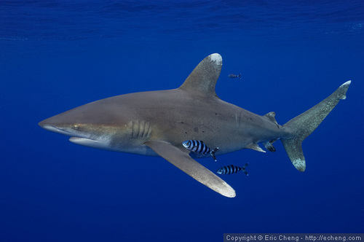
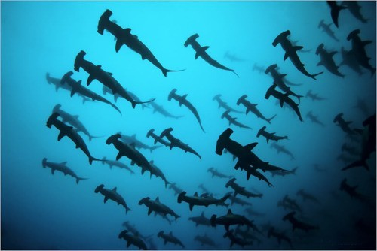
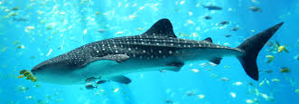
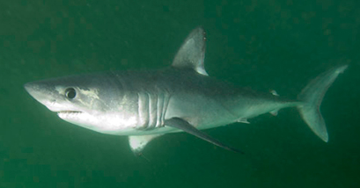
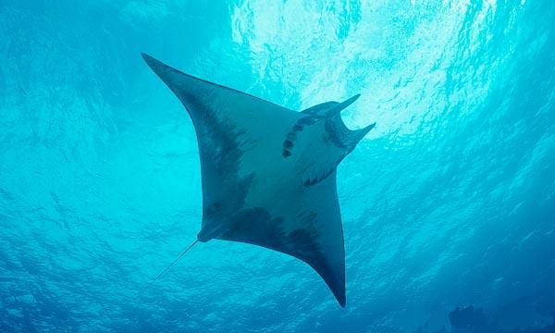
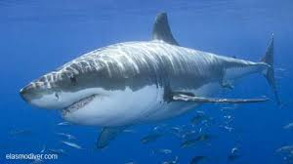
Sharks/Manta rays in Appendix II
Cetorhinus maximus (Basking shark)
Carcharhinus longimanus (Oceanic whitetip shark)
Sphyrna lewini, S.mokarran,
S. zygaena
(Hammerhead sharks)
Rhincodon typus
(Whale shark)
Lamna nasus
(Porbeagle shark)
Manta spp.
(Manta rays)
Entry into effect delayed to 14 September 2014
Carcharodon carcharias
(Great white shark)
Notes:
These are examples of sharks and manta rays listed in CITES Appendix II. The species in the dotted line are those adopted at CITES CoP16, and for which Parties decided to delay the entry into effect until 14 September 2014.

Slide 17
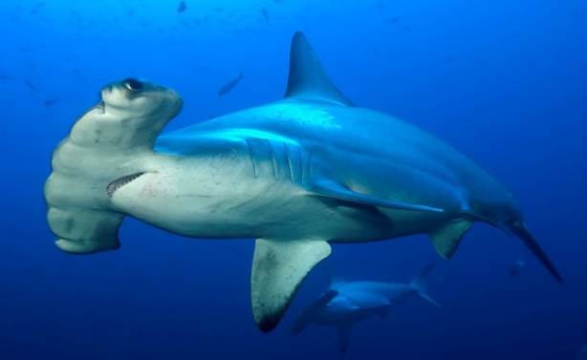
CITES Appendix III
  Species for which a country is asking Parties to help with its protection
  International trade is permitted but regulated
  (less restrictive than Appendix II)
  1% of CITES trade (no CoP decision needed)
Lamna nasus*
(Belgium, Cyprus, Denmark, Estonia, Finland, France, Germany, Greece, Ireland, Italy, Latvia, Lithuania, Malta, Netherlands, Poland, Portugal, Slovenia, Spain, Sweden and United Kingdom of Great Britain and Northern Ireland)
Sphyrna lewini*
(Costa Rica)
*Until 14 September 2014
Notes:
Lastly, CITES Appendix III consists of species whose exploitation is regulated in one Party and that Party needs the cooperation of other Parties for the control of trade.
International (commercial ) trade is permitted but regulated (less restrictive than Appendix II).
Such species constitute 1% of all listings. Unlike the other two Appendices, no decision from the Conference of the Parties is needed to add a species to this Appendix. The listing is decided by the Party or Parties concerned.

Slide 18
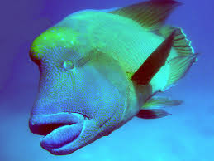
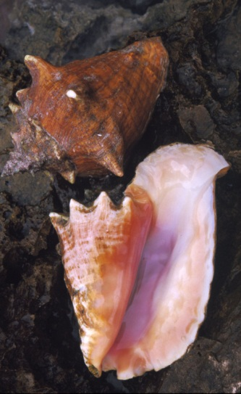
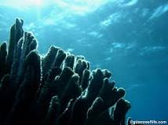
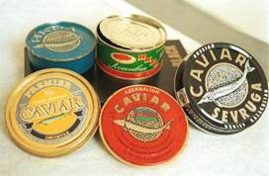
Other marine species in
CITES Appendices
Humphead wrasse
(Napoleon fish) - Appendix II
Queen conch – Appendix II
Giant clams – Appendix II
Hard corals, black corals
– Appendix II
European eel – Appendix II
Sturgeons – Appendix I & II
Notes:
A number of other marines species of commercial importance are also regulated by CITES. Here are some examples.

Slide 19
CITES listing criteria
Biological criteria
Low productivity (slow-growing,
small number of pups),
behavioral vulnerability to harvesting
Trade criteria
(historic population declines related to international trade in fins, meat and bycatch)
  Great and Smooth hammerheads: specimens most frequently traded resemble those of the scalloped hammerhead to such an extent that enforcement officers are unlikely to be able to distinguish them
Notes:
For any species to be considered for listing under CITEs Appendices, biological and trade criteria must be met – these criteria are applied for the new listing of sharks and manta rays as well.
For the sharks and manta rays, these factors were considered:
Biological criteria: Low productivity (slow-growing, small number of pups), behavioral vulnerability to harvesting
Trade criteria: historic population declines related to international trade in fins, meat and bycatch
Furthermore Great and Smooth hammerhead sharks were included because they met a particular trade criteria, in that specimens in their trade resemble those of the Scalloped hammerhead sharks, to such an extent that enforcement officers are unlikely to be able to distinguish them.

Slide 20
What should Parties do by
14 Sept. 2014?
Countries wishing to (re-)export or import specimens of the recently CITES-listed sharks and rays after 14th September 2014 have to meet certain requirements.
Notes:
As mentioned before, at CoP16 Parties decided to delay the entry into effect of the listings of sharks and manta rays until 14 September 2014. This means that countries wishing to export, re-export or import specimens of the recently CITES-listed sharks and rays after 14th September 2014 have to meet certain requirements in order to comply with CITES requirements.
Let us look at what they might be.

Slide 21
What should Parties do by
14 Sept. 2014?
Legality
National laws, legal aquisition, RFMOs, enforcement, …
Sustainability
NDFs, science, Introduction From the Sea, …
Traceability
Permits, identification, reporting, databases
Notes:
The requirements of CITES implementation can be divided into the three main objectives of CITES: ensuring legality, sustainability, and traceability. Under each of them, there are a number of processes and tools that could be considered by countries.

Slide 22
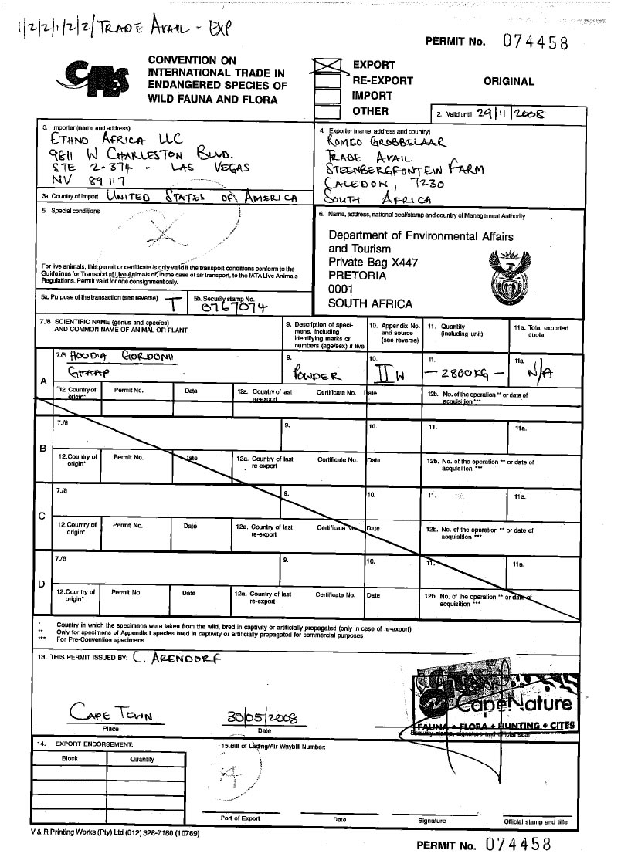
CITES Permits and Certificates

Slide 23
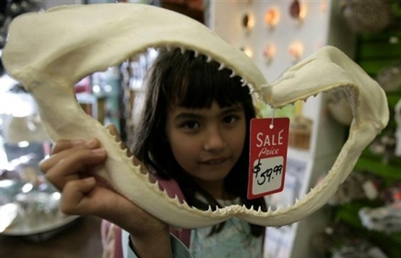
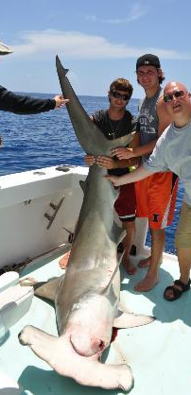
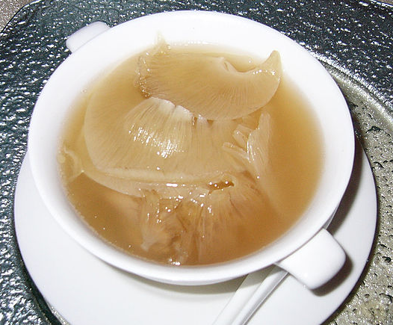
CITES permits and certificates
import
export
re-export
introduction from the sea
Animals and plants
(live, dead, parts and derivatives)
Permits and certificates
issued under certain conditions:
  Lawfully obtained
  Trade will not be detrimental to the survival
  of the species
Notes:
CITES regulates export, re-export, import and introduction from the sea of live and dead animals and plants, their parts and derivatives (listed species only) through a system of permits and certificates
These permits or certificates may only be issued if certain conditions are met, The documents must be presented when leaving or entering a country.
For Appendix I and II species, the most important conditions are
legal acquisition and
that international trade must not be detrimental to the survival of the species

Slide 24
CITES permits and certificates
Provides:
  Scientific information
  (non-detrimental findings)
  Legal origin & sourcing
  Trade data
  Purpose of the trade
  Duration of validity
Notes:
CITES permits and certificated commonly provide the following information.

Slide 25
Trade with non-Parties
  Comparable documentation may be accepted
  issued by competent authorities
  conforms with CITES requirements for permits and certificates
Details of the competent authorities and scientific institutions must be included in the CITES Directory
Notes:
Where export or re-export is to, or import is from, a non-Party, comparable documentation issued by the competent authorities which substantially conforms with CITES requirements for permits and certificates may be accepted
Parties accept documentation from States not party to the Convention only if the details of the competent authorities and scientific institutions of such States are included in the online CITES Directory
This also applies to specimens in transit destined for or coming from non-Parties

Slide 26
Collaboration and cooperation are essential for CITES implementation
National stakeholders include:
  CITES Authorities
  Natural resources sector (fisheries, forestry, etc.)
  Businesses (traders, wholesalers, transport, etc.)
  Customs
  Police
  Judiciary
  Others
Notes:
For a successful CITES implementation, collaboration and cooperation among different stakeholders at the national level is essential. These are some of the sectors where CITES stakeholders may be present.
Close cooperation with the CITES Authorities with these other sectors would be vital.

Slide 27
Summary: CITES is…
Intergovernmental agreement on international trade in wild fauna and flora
Legality, traceability, and sustainability
Legal framework & procedural mechanisms
system of permits and certificates
Inter-agency and inter-sector collaboration
Notes:
CITES is an international , legally-binding agreement between governments aimed at ensuring that no species of wild fauna or flora is unsustainably exploited for international trade.
It is aimed at ensuring legality, traceability, and sustainability.
The Convention establishes the international legal framework and common procedural mechanisms for an effective regulation of international trade in Appendix-II and -III species, and for the control of international trade in Appendix-I species
CITES regulates international trade in wild fauna and flora listed in its Appendices on the basis of a system of permits and certificates which are issued when certain conditions are met, and which must be presented when leaving and entering a country
Inter-agency and inter-sector collaboration is essential for the effective implementation of CITES

Slide 28







Thank you for your attention!
CITES and FAO working for legal, sustainable and traceable international trade in sharks and manta rays, supported by the European Union

