Slide 1
CITES and Sharks and Manta Rays
CITES Secretariat
Geneva

Slide 2
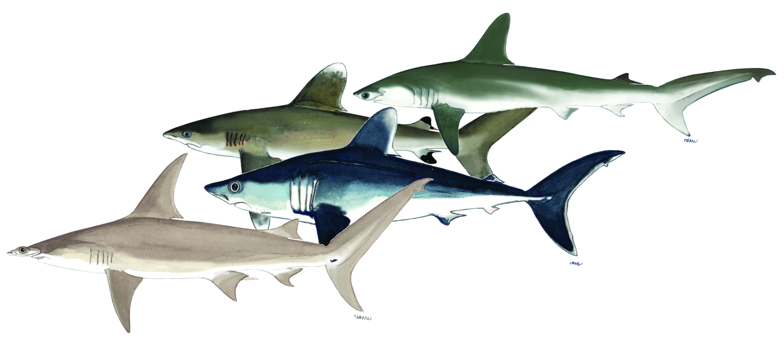
CITES Appendices and Sharks

Slide 3
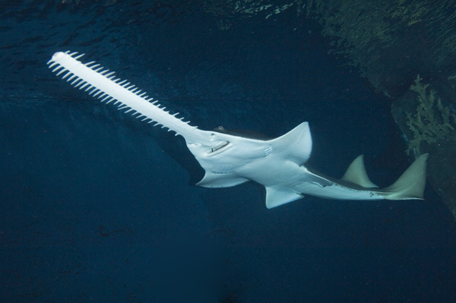
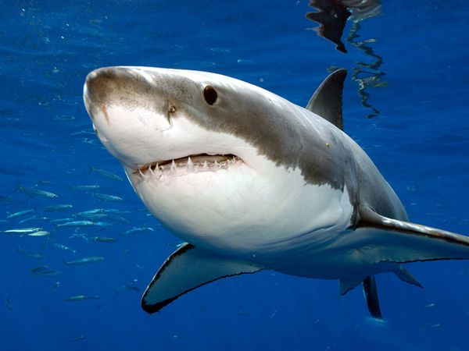
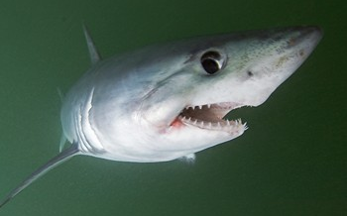
CITES Appendices
Species* regulated under CITES are divided amongst 3 Appendices
I
II
III
* "Species" means any species, subspecies, or geographically separate population thereof”
Notes:
Now, let’s look at how CITES is regulated. Species regulated under CITES are divided amongst 3 Appendices.

Slide 4
CITES Appendix I
Species threatened with extinction, which are or may be affected by trade
International (commercial) trade in wild specimens is generally prohibited
3% of all listings (Conference of the Parties to decide)
Sawfishes: Pristidae spp.
Notes:
CITES Appendix I includes species threatened with extinction, which are or may be affected by trade.
For these species, international commercial trade in wild specimens is generally prohibited. As mentioned earlier, such species constitute 3% of all listings.
In order to add new species to this category or remove a species from Appendix I (either to delete it from the CITES Appendices altogether, or to ‘downlist’ it to Appendix II).
, a decision by the Conference of the Parties to CITES is needed.
An example of marine species listed in CITES Appendix I are the various species of sawfish, the Pristidae.

Slide 5
CITES Appendix II
  Species not necessarily currently threatened with extinction, but may become so unless trade is strictly regulated to avoid utilization incompatible with their survival
  Also, species that resemble species already included in Appendix II
  International (commercial) trade is permitted but regulated
  96% of all listings (Conference of the Parties to decide)
Notes:
CITES Appendix II, on the other hand, include species not necessarily currently threatened with extinction, but that may become so unless trade is strictly regulated to avoid utilization incompatible with their survival.
Appendix II also contains what is called the «look-alike» species, which are species that resemble species already included in Appendix II to such an extent that enforcement officers are unlikely to be able to distinguish them.
For these species, international commercial trade in wild specimens is generally permitted, but regulated through a system of permits and certificates. Such species constitute 96% of all listings.
As for Appendix I, a decision by the Conference of the Parties to CITES is needed in order to add new species to this category, or to remove a species from this category (either to delete it from the CITES Appendices, or to ‘uplist’ it to Appendix I).

Slide 6
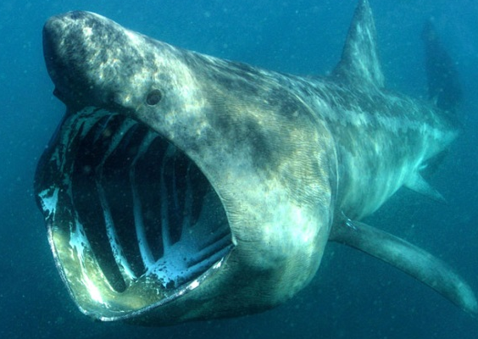
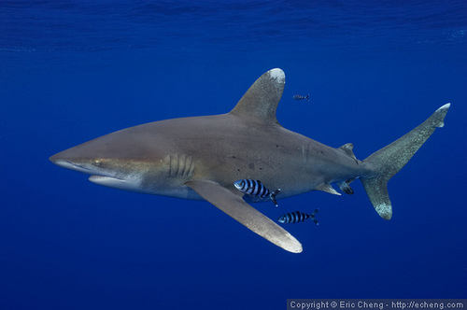
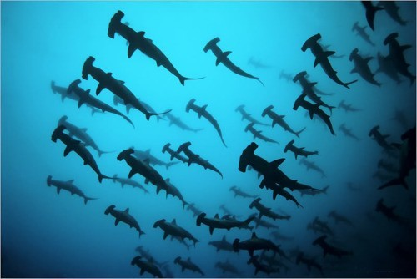
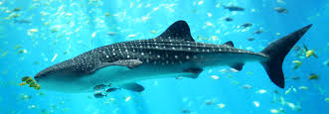
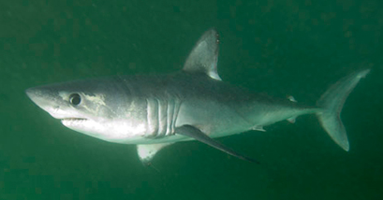
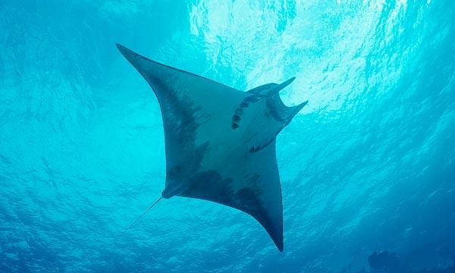
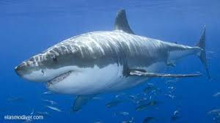
Sharks/Manta rays in Appendix II
Cetorhinus maximus (Basking shark)
Carcharhinus longimanus (Oceanic whitetip shark)
Sphyrna lewini, S.mokarran,
S. zygaena
(Hammerhead sharks)
Rhincodon typus
(Whale shark)
Lamna nasus
(Porbeagle shark)
Manta spp.
(Manta rays)
Entry into effect delayed to 14 September 2014
Carcharodon carcharias
(Great white shark)
Notes:
These are examples of sharks and manta rays listed in CITES Appendix II. The species in the dotted line are those adopted at CITES CoP16, and for which Parties decided to delay the entry into effect until 14 September 2014.

Slide 7
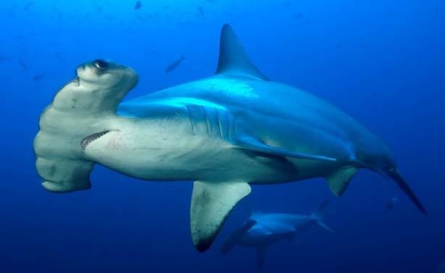
CITES Appendix III
  Species for which a country is asking Parties to help with its protection
  International trade is permitted but regulated
  (less restrictive than Appendix II)
  1% of CITES Trade (no CoP decision needed)
Lamna nasus*
(Belgium, Cyprus, Denmark, Estonia, Finland, France, Germany, Greece, Ireland, Italy, Latvia, Lithuania, Malta, Netherlands, Poland, Portugal, Slovenia, Spain, Sweden and United Kingdom of Great Britain and Northern Ireland)
Sphyrna lewini*
(Costa Rica)
*Until 14 September 2014
Notes:
Lastly, CITES Appendix III consists of species whose exploitation is regulated in one Party and that Party needs the cooperation of other Parties for the control of trade.
International (commercial ) trade is permitted but regulated (less restrictive than Appendix II).
Such species constitute 1% of all listings. Unlike the other two Appendices, no decision from the Conference of the Parties is needed to add a species to this Appendix. The listing is decided by the Party or Parties concerned.

Slide 8
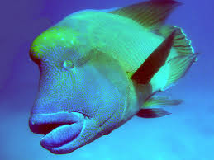
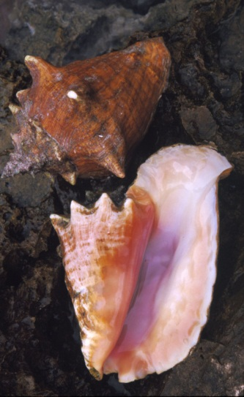
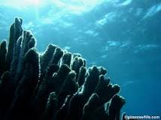
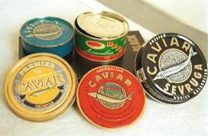
Other marine species in
CITES Appendices
Humphead wrasse
(Napoleon fish) - Appendix II
Queen conch – Appendix II
Giant clams – Appendix II
Hard corals, black corals
– Appendix II
European eel – Appendix II
Sturgeons – Appendix I & II
Notes:
A number of other marines species of commercial importance are also regulated by CITES. Here are some examples.

Slide 9
CoP16 (Bangkok, March 2013)
Five shark species and all manta rays were included in Appendix II
Delayed entry into effect on 14 September 2014
  in order to resolve technical and administrative issues related to their implementation
EU contributing 1.2 million EUR to CITES for assisting developing countries in their implementation of the new listings of sharks and manta rays
Notes:
Specifically on the issue of sharks….at the 16th meeting of the Conference of the Parties to CITES, CoP16, held in Bangkok in March this year, the Parties decided to place five shark species and all manta rays in Appendix II.
Parties also agreed that their entry into effect would be delayed until 14 September 2014 in order to resolve technical and administrative issues related to their implementation.
At the same meeting, the EU announced that it was contributing 1.2 million EUR to CITES for assisting developing countries in their implementation of the new listings of sharks and manta rays. Other bilateral and multilateral support has also been made available to Parties.

Slide 10
Which sharks and rays were listed in Appendix II at CoP16?
Sphyrna lewini, S.mokarran,
S. zygaena
(Hammerhead sharks)
Carcharhinus longimanus (Oceanic whitetip shark)
Lamna nasus
(Porbeagle shark)
Manta spp.
(Manta rays)

Slide 11
CITES listing criteria for the new sharks and manta rays
Biological criteria
Low productivity (slow-growing,
small number of pups),
behavioral vulnerability to harvesting
Trade criteria
(historic population declines related to international trade in fins, meat and bycatch)
  Great and Smooth hammerheads: specimens most frequently traded resemble those of the scalloped hammerhead to such an extent that enforcement officers are unlikely to be able to distinguish them
Notes:
For any species to be considered for listing under CITEs Appendices, biological and trade criteria must be met – these criteria are applied for the new listing of sharks and manta rays as well.
For the sharks and manta rays, these factors were considered:
Biological criteria: Low productivity (slow-growing, small number of pups), behavioral vulnerability to harvesting
Trade criteria: historic population declines related to international trade in fins, meat and bycatch
Furthermore Great and Smooth hammerhead sharks were included because they met a particular trade criteria, in that specimens in their trade resemble those of the Scalloped hammerhead sharks, to such an extent that enforcement officers are unlikely to be able to distinguish them.

Slide 12
What should Parties do by
14 Sept. 2014?
Countries wishing to (re-)export or import specimens of the recently CITES-listed sharks and rays after 14th September 2014 have to meet certain requirements.
Notes:
As mentioned before, at CoP16 Parties decided to delay the entry into effect of the listings of sharks and manta rays until 14 September 2014. This means that countries wishing to export, re-export or import specimens of the recently CITES-listed sharks and rays after 14th September 2014 have to meet certain requirements in order to comply with CITES requirements.
Let us look at what they might be.

Slide 13
What should Parties do by
14 Sept. 2014?
Legality
National laws, legal aquisition, RFMOs, enforcement, …
Sustainability
NDFs, science, Introduction From the Sea, …
Traceability
Permits, identification, reporting, databases
Notes:
The requirements of CITES implementation can be divided into the three main objectives of CITES: ensuring legality, sustainability, and traceability. Under each of them, there are a number of processes and tools that could be considered by countries.

Slide 14
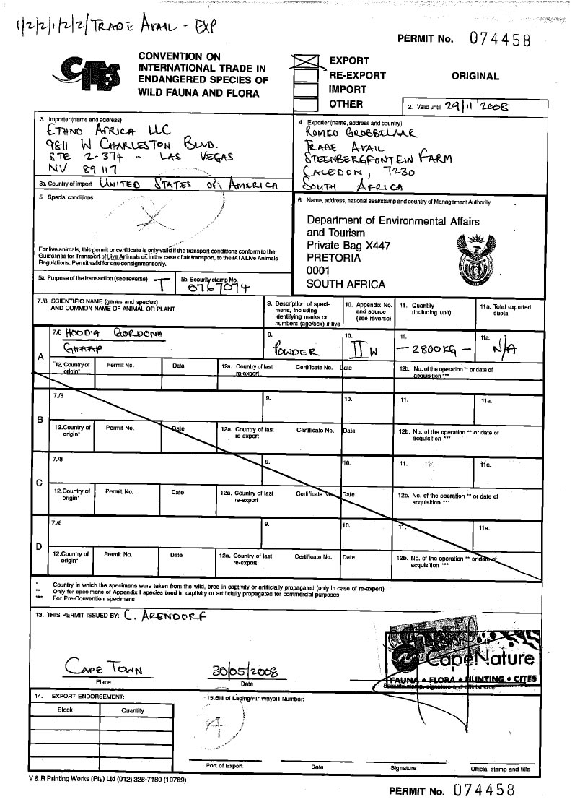
CITES Permits and Certificates

Slide 15

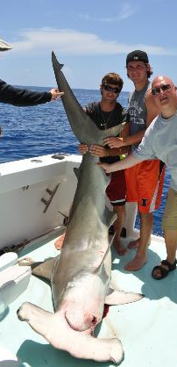
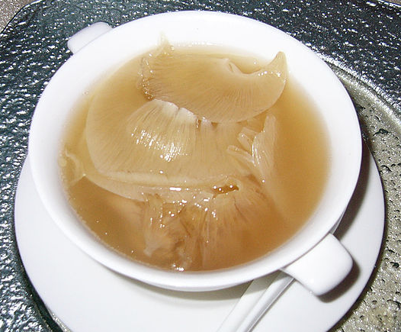
CITES permits and certificates
import
export
re-export
introduction from the sea
Animals and plants
(live, dead, parts and derivatives)
Permits and certificates
issued under certain conditions:
  Lawfully obtained
  Trade will not be detrimental to the survival
  of the species
Notes:
CITES regulates export, re-export, import and introduction from the sea of live and dead animals and plants, their parts and derivatives (listed species only) through a system of permits and certificates
These permits or certificates may only be issued if certain conditions are met, The documents must be presented when leaving or entering a country.
For Appendix I and II species, the most important conditions are
legal acquisition and
that international trade must not be detrimental to the survival of the species

Slide 16
CITES permits and certificates
Provides:
  Scientific information
  (non-detrimental findings)
  Legal origin & sourcing
  Trade data
  Purpose of the trade
  Duration of validity
Notes:
CITES permits and certificated commonly provide the following information.

Slide 17
Trade with non-Parties
  Comparable documentation may be accepted
  issued by competent authorities
  conforms with CITES requirements for permits and certificates
Details of the competent authorities and scientific institutions must be included in the CITES Directory
Notes:
Where export or re-export is to, or import is from, a non-Party, comparable documentation issued by the competent authorities which substantially conforms with CITES requirements for permits and certificates may be accepted
Parties accept documentation from States not party to the Convention only if the details of the competent authorities and scientific institutions of such States are included in the online CITES Directory
This also applies to specimens in transit destined for or coming from non-Parties

Slide 18
Collaboration and cooperation are essential for CITES implementation
National stakeholders include:
  CITES Authorities
  Natural resources sector (fisheries, forestry, etc.)
  Businesses (traders, wholesalers, transport, etc.)
  Customs
  Police
  Judiciary
  Others
Notes:
For a successful CITES implementation, collaboration and cooperation among different stakeholders at the national level is essential. These are some of the sectors where CITES stakeholders may be present.
Close cooperation with the CITES Authorities with these other sectors would be vital.

Slide 19







Thank you for your attention!
CITES and FAO working for legal, sustainable and traceable international trade in sharks and manta rays, supported by the European Union

