Slide 1
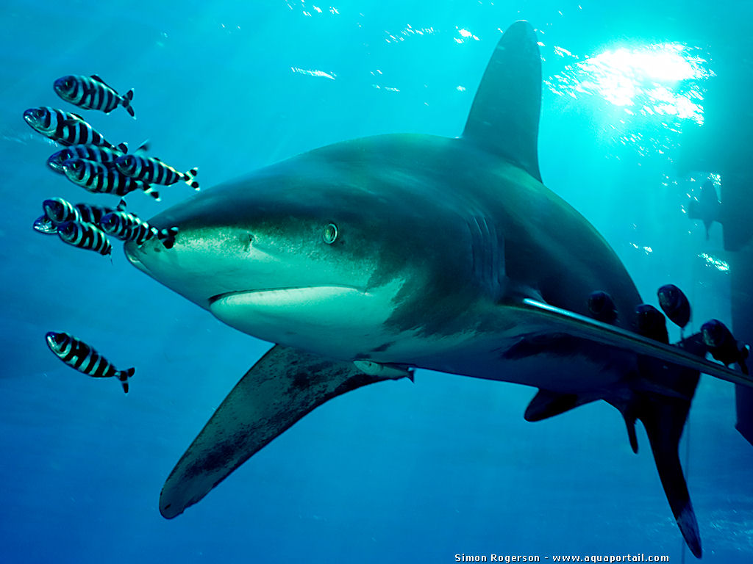
Newly listed sharks and manta rays: What should Parties do by 14 Sept. 2014: Sustainability
Notes:
The requirements of CITES implementation can be divided into the three main objectives of CITES: ensuring legality, sustainability, and traceability. Under each of them, there are a number of processes and tools that could be considered by countries.

Slide 2
Sustainability
CITES Scientific Authorities must:
Determine that proposed trade will not be detrimental to the survival of the species
Monitor both the export permits granted and the actual exports and whenever they determine that the export should be limited, in order to maintain the species throughout its range at a level consistent with its role in the ecosystems and well above the level at which it might qualify inclusion in Appendix I, advise the CITES Management Authority of suitable measures to be taken to limit the grant of export permits for specimens of that species.

Slide 3
Scientific assessments: Non-detriment findings (NDFs)
Parties must ensure trade will not be detrimental to the survival of the species, through scientific assessments on species status in the national/regional territory
(CITES Art. III & IV)
NDF is effectively advice by a Scientific Authority of the exporting country that a proposed trade transaction will not be detrimental to the survival of a species

Slide 4
Scientific assessments: Non-detriment findings (NDFs)
NDFs are the responsibility of the competent Scientific Authorities in the State undertaking the export or introduction from the sea

Slide 5
Sustainability – NDFs are not…
One-size-fits-all for all species and countries
A prescriptive ‘standard’ with specific thresholds or demands
Determined by bodies outside of the State of export/introduction from the sea

Slide 6
Sustainability - NDFs can …
Use best available scientific information
Use different methodologies
Establish nationally-established quotas
Be made in consultation with other national Scientific Authorities, international scientific agencies (Article IV Para.7)

Slide 7
Sustainability - Non-detriment findings (NDFs)
Examples of elements of NDFs:
Species biology, range, population, threats
Population structure, status and trends
Harvest and mortality data
Management measures (in place or proposed)
Monitoring/conservation status
Population monitoring
(Resolution conf. 16.7)

Slide 8
Sustainability - Non-detriment findings (NDFs)
Recommended issues to take into account:
Volume of trade vs. vulnerability of species
Correct identification of the species
Methodology reflecting origin, type, taxonomic characteristics of specimen exported
Implementation of adaptive management
(Resolution conf. 16.7)

Slide 9
Sustainability - Non-detriment findings (NDFs)
In making NDFs, States may use…
Scientific literature
Ecological risk assessments
Scientific surveys
Knowledge and expertise of local and indigenous communities
Consultations with local, regional and international experts
National and international trade information
(Resolution conf. 16.7)

Slide 10
Sustainability - Non-detriment findings (NDFs)
Parties are encouraged to:
explore methods for making NDFs
share experiences and examples of ways of making NDFs, including through regional or subregional workshops
maintain written records of the science-based rationale included in the Scientific Authorities’ NDF assessments
to offer, on request, cooperative assistance to developing countries, for improvement of capacity to make NDFs, based on nationally identified needs.

Slide 11
Non-detriment findings (NDFs): Compliance procedure?
Authorized trade is likely to take place at unsustainable levels if:
There is no adequately functioning mechanism for the Scientific Authority to advise on safe levels of trade, or
Non-detriment findings are incorrect or not made, or
The Management Authority issues export permits contrary to the advice of the Scientific Authority, or
No adequate monitoring takes place

Slide 12
Thank you for your attention! CITES and FAO working for legal, sustainable and traceable international trade in sharks and manta rays, supported by the European Union

