Slide 1
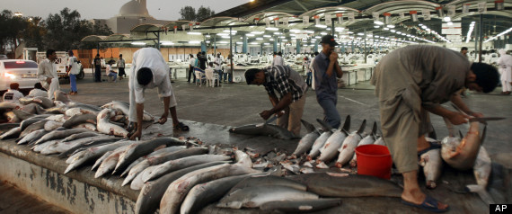
CITES Non-Detriment Findings (NDFs) and the Review of Significant Trade

Slide 2
Article IV: the heart of CITES
Commercial international trade in Appendix-II species may take place, but only if the Management Authority of the exporting State issues an export permit
No such permits should be issued unless the Scientific Authority of the exporting State advises that the export which is to take place will not be detrimental to the survival of the species

Slide 3
Article IV: the heart of CITES
Authorized trade is likely to take place at unsustainable levels if:
there is no adequately functioning mechanism for the Scientific Authority to advise on safe levels of trade, or
“non-detriment” findings are incorrect or not made, or
the Management Authority issues export permits contrary to the advice of the Scientific Authority, or
no adequate monitoring takes place

Slide 4
Include in Appendix I
If a regime of unsustainable trade in an Appendix-II species is not noted and rectified in the monitoring process expected of the Scientific Authority, then ultimately a proposal may be formulated by other Parties for the inclusion of the species in Appendix I
If accepted by the Parties, then the problem will finally be addressed by the prohibition of all commercial trade

Slide 5
The Significant Trade Review process
The Significant Trade Review process, if implemented correctly, acts as a safety net by ensuring that species do not decline because of trade while they are listed in Appendix II
If corrective measures are taken in a timely manner, then there should be a reduction in the number of animal and plant species that need to be transferred from Appendix II to Appendix I because they are endangered by international trade

Slide 6
The Significant Trade Review process
The process is conducted by the Animals and Plants Committees
The Committees have a mandate to identify Appendix-II species subject to significant levels of trade that are of immediate concern
They consult with range States, the CITES Secretariat and experts to review and assess relevant biological and trade information
If necessary, they make recommendations for action by range States where exports are problematic, with time limits for implementation

Slide 7
The Significant Trade Review process
Resolution Conf. 12.8 (Rev. CoP13) also spells out when each of the participants in the process has a particular task to carry out
The Review is a process to ensure that provisions of Article IV are being met, and trade is sustainable and not detrimental to the survival of the species

Slide 8
A 3-stage process
The Significant Trade Review process for Appendix-II listed species comprises three stages:
Stage 1 - Selection
Compilation of a list of species traded at ‘significant levels’ that are of immediate concern
Stage 2 - Review
Consultation and review to identify possible problems in the implementation of Article IV for selected species
Stage 3 - Actions
Processes to improve the implementation of Article IV where necessary

Slide 9
The process
Points where species could exit process
Species selection
AC/PC
Consultation
Secretariat
AC/PC first review
Recommendations AC/PC implementation reviewed
Secretariat + Chair
AC/PC review and categorization
Research
Secretariat
Recommendations AC/PC implementation reviewed
Species of urgent concern
Species of possible concern
Recategorization
AC/PC
SC action

Slide 10
Benefits of the Significant Trade Review
Reduces tendency of importing countries to apply unilateral stricter domestic measures (such as import bans or externally-imposed export quotas for range States)
Eliminates risk of transfer to Appendix-I
Exporting countries may receive external support to undertake field studies and develop technical and administrative capacity necessary to implement the requirements of Article IV

Slide 11
Thank you for your attention! CITES and FAO working for legal, sustainable and traceable international trade in sharks and manta rays, supported by the European Union

