Slide 1
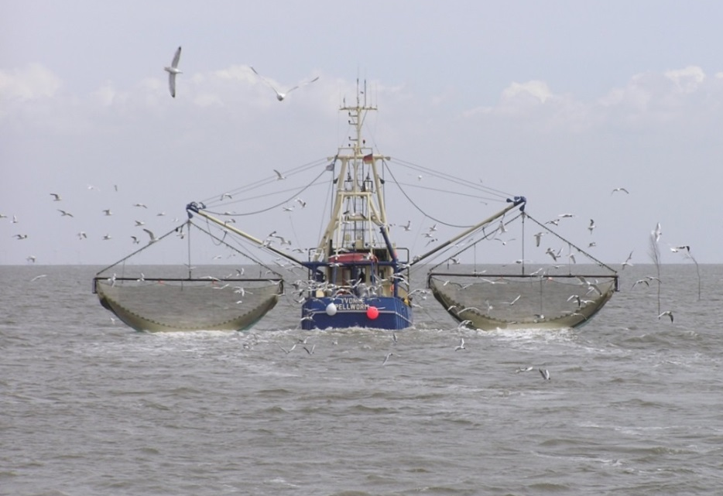
Introduction From the Sea (IFS)

Slide 2
background
This slide page is hidden from view in presentation mode. When printing, please make sure that the “print hidden slides” option is deselected.
The aim for this section is to provide a background to the IFS definition and the concept of “high seas”(specimens taken in the marine environment not under the jurisdiction of any State).
If the audience is not familiar with CITES in general, please consider adding slides from “CITES introduction.pptx”.
If you need to add more introductory information about CITES-listing of sharks and manta rays, please add slides from “CITES Sharks and Manta rays.pptx”.

Slide 3

Introduction From the Sea (IFS)
One of 4 types of trade regulated by CITES
A prior grant of an IFS certificate is required
[Convention Article III 5 and Article IV 6 and 7]
Involves “specimens taken in the marine environment not under the jurisdiction of any State“
[Convention Article I(c)]
re-export
introduction from the sea
export
import

Slide 4
“marine environment not under the jurisdiction of any State”
(commonly known as)
High seas
The Conference of the Parties (CoP) has agreed that this means:
“those marine areas beyond the areas subject to the sovereignty or sovereign rights of a State, consistent with international law,
as reflected in the United Nations Convention on the Law of the Sea"
[Resolution Conf. 14.6 (Rev. CoP16)]

Slide 5
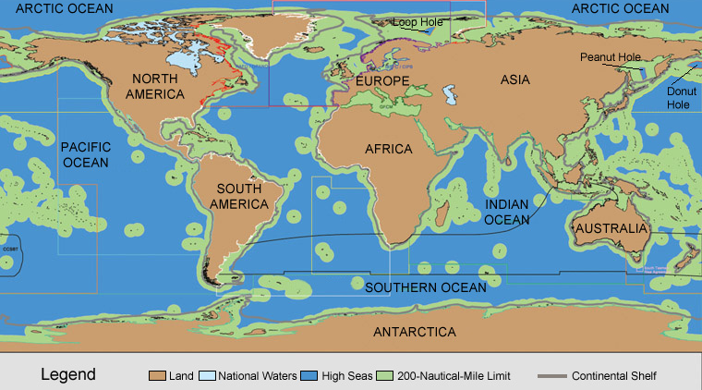
The world’s high seas
71% of the Earth is covered by ocean
64% of the ocean is considered high seas/ international waters
The high seas cover 45% of the Earth’s surface
Source: Fisheries and Oceans Canada

Slide 6
What is IFS? WHAT is not IFS?
This slide page is hidden from view in presentation mode. When printing, please make sure that the “print hidden slides” option is deselected.
The aim for this section is to explain that IFS applies to a specific (and relatively straightforward) transaction involving CITES specimens taken from the high seas.

Slide 7
What is IFS?
“Transportation into a State of
specimens of any species which were taken in the marine environment not under the
jurisdiction of any State”
Need for a common understanding to facilitate the standard implementation of trade controls
[Resolution Conf. 14.6 (Rev. CoP16), preamble]

Slide 8
What is IFS?
“Transportation into a State of specimens of any species which were taken in the marine environment not under the jurisdiction of any State”
?
?
?
?
Source: Fisheries and Oceans Canada

Slide 9
What is IFS: issues to consider
What
is being taken?
Is the specimen listed in CITES Appendix I or II?
Who
is taking it?
Which State owns the vessel?
Is the vessel chartered?
Where
is it taken from?
In which State was it landed?
?
IFS
export

Slide 10

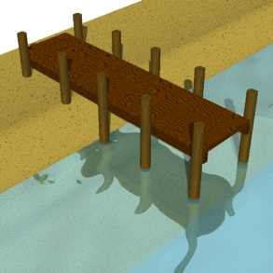
IFS is a one-State transaction
A
A
I F S
The same State
Takes the specimens from the high seas;
Serves as the State of introduction; and
Issues an IFS certificate.

Slide 11
Two or more States = export/import
A
B
State of export
State of import

Slide 12
What do we need to do?
This slide page is hidden from view in presentation mode. When printing, please make sure that the “print hidden slides” option is deselected.
This section sums up what Parties need to do for IFS.
If the audience is not familiar with non-detriment findings (NDFs), please add slides from “NDFs and the review of Sig Trade.pptx”.

Slide 13
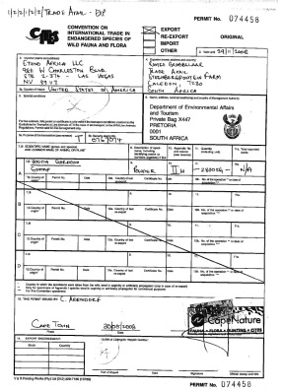
IFS certificate = traceability
A CITES certificate must be issued by
the State of introduction, and
the source code ‘X’ be used to indicate IFS
X
X
X
CITES certificate
Annual reports
CITES trade database
[Resolution Conf. 12.3 (Rev. CoP16) section I(i)]

Slide 14
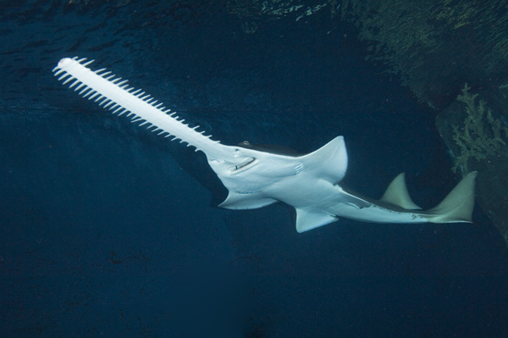
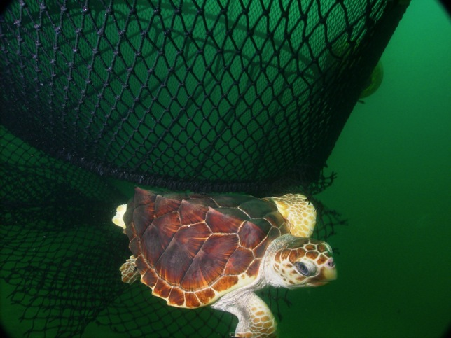
IFS for Appendix-I specimens
Before an IFS certificate is granted, the State of introduction must ensure:
Scientific Authority
Management Authority
  Non-detriment (sustainability) finding (NDF)
  Specimen not to be used for primarily commercial purposes
  Recipient of living specimen suitably equipped to house and care for it
[CITES Art III 5]

Slide 15
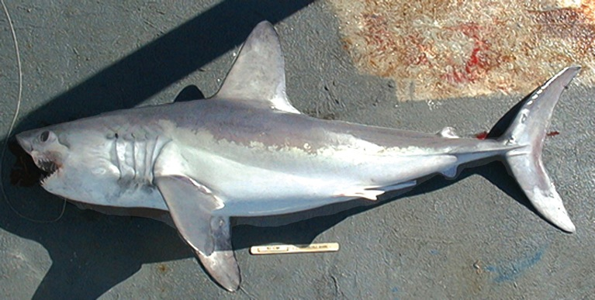
IFS for Appendix-II specimens
Before an IFS certificate is granted, the State of introduction must ensure:
Scientific Authority
Management Authority
  Non-detriment (sustainability) finding (NDF)
  Living specimen handled so as to minimize the risk of injury, damage to health or cruel treatment
[CITES Art IV 6 and 7]
  may involve consultation with other national SAs or international scientific authorities

Slide 16
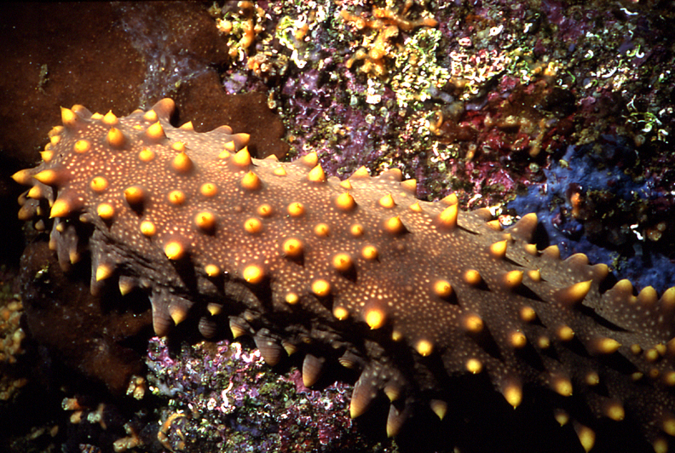
No IFS for Appendix-III specimens
Introduction from the sea does not apply to Appendix-III specimens
[CITES Art V]
Brown sea cucumber (Isostichopus fuscus) (Included in Appendix III by Ecuador)

Slide 17
IFS in a broader context
This slide page is hidden from view in presentation mode. When printing, please make sure that the “print hidden slides” option is deselected.
This section sums up how CITES and IFS is placed among other related legal instruments.
The aim of the section is to show that CITES and IFS measures are complementary to other legal instruments, notably that of fisheries management.

Slide 18
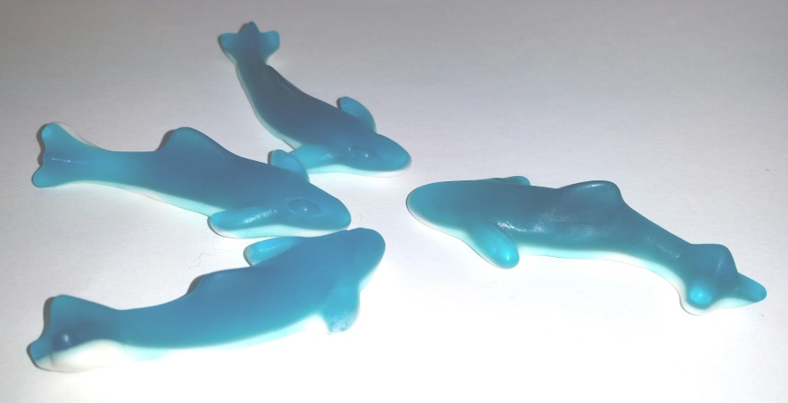
IFS involves consultation & cooperation
  with Regional Fishery
  Management
  Organizations and
  Arrangements (RFMO/As)
  with FAO’s progress to promote responsible fisheries, e.g. IPOA-Sharks and 2009 Port State Measures Agreement
[Resolution Conf. 14.6 (Rev. CoP16)]

Slide 19
Regional Fisheries Management Organizations (RFMOs) and Regional Fishery Bodies (RFBs)

Slide 20
IFS: consistency with applicable measures
Parties take into account whether or not the specimen is acquired and landed:
In a manner consistent with applicable measures under international law, e.g. other treaty, convention, agreement; and
through any illegal, unreported or unregulated (IUU) fishing activity.
[Resolution Conf. 14.6 (Rev. CoP16)]

Slide 21
Relationship with other laws & conventions
Parties respect obligations which are…
deriving from conventions which are in force at the time CITES entered into force, and which afford protection to marine species in App II
IFS
Other laws and conventions
related to codification and development of the UN Convention on the Law of the Sea (UNCLOS)
[CITES Art XIV]

Slide 22

UNCLOS and BBNJ
    UNCLOS:
    sets out the legal framework for all activities in the oceans and seas;
    has gaps regarding biodiversity in areas beyond national jurisdiction (ABNJ).
Notes:
For general information regarding UNCLOS, the website of the Division of Oceans and Law of the Sea offers good resources: http://www.un.org/depts/los/index.htm
A full text of UNCLOS can be found here: http://www.un.org/depts/los/convention_agreements/texts/unclos/unclos_e.pdf
Some definitions relevant to the BBNJ discussion:
- Part I, Article 1 (1) defines the "Area" (including the seabed)
- Part VII on "High Seas" defines "High Seas" and sets out the provisions that apply.
The BBNJ Working Group was established through paragraph 73 of A/RES/59/24 (http://www.un.org/ga/search/view_doc.asp?symbol=A/RES/59/24)
In the Rio+20 Outcome document paragraph 162 sets the deadline of the end of the 69th session of the UN General Assembly to "tak[e] a decision on the development
of an international instrument under the Convention on the Law of the Sea"
(http://daccess-dds-ny.un.org/doc/UNDOC/GEN/N11/476/10/PDF/N1147610.pdf?OpenElement)

Slide 23
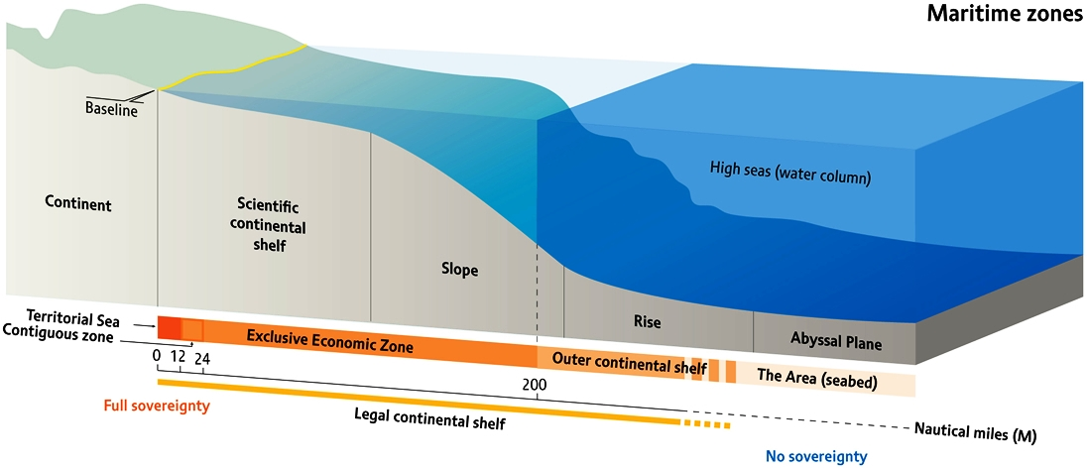
UNCLOS and BBNJ
    Since 2004: Ad hoc Open-ended Informal Working Group (aka biodiversity beyond national jurisdiction or BBNJ working group)
    In Rio+20 outcome documents States committed to take a decision on the development of an international instrument under UNCLOS by 69th General Assembly
    Scope: high seas and deep seabed
[Source: Riccardo Pravettoni, UNEP/GRID-Arendal, 2009]
Notes:
For general information regarding UNCLOS, the website of the Division of Oceans and Law of the Sea offers good resources: http://www.un.org/depts/los/index.htm
A full text of UNCLOS can be found here: http://www.un.org/depts/los/convention_agreements/texts/unclos/unclos_e.pdf
Some definitions relevant to the BBNJ discussion:
- Part I, Article 1 (1) defines the "Area" (including the seabed)
- Part VII on "High Seas" defines "High Seas" and sets out the provisions that apply.
The BBNJ Working Group was established through paragraph 73 of A/RES/59/24 (http://www.un.org/ga/search/view_doc.asp?symbol=A/RES/59/24)
In the Rio+20 Outcome document paragraph 162 sets the deadline of the end of the 69th session of the UN General Assembly to "tak[e] a decision on the development
of an international instrument under the Convention on the Law of the Sea"
(http://daccess-dds-ny.un.org/doc/UNDOC/GEN/N11/476/10/PDF/N1147610.pdf?OpenElement)

Slide 24
UNCLOS and BBNJ
January 2015: BBNJ working group recommended to the General Assembly to develop an international instrument under UNCLOS:
  Marine genetic resources including access & benefit sharing
  Area based management tools, including marine protected areas
  Environmental Impact Assessments
  Capacity building and technology transfer
Fisheries are excluded (tentatively)
Work of the Preparatory committee will commence in 2016 and report by the end of 2017
Notes:
For a good and concise (academic) summary of the status of the negotiations up to 2013, including the 2011 package on which the current recommendation is based, see Druel, E., Billé, R., Rochette, J. (2013) Getting to yes? Discussions towards an Implementing Agreement to UNCLOS on biodiversity in ABNJ, IDDRI Policy Briefs N°10/2013 Biodiversity
(http://www.iddri.org/Publications/Getting-to-yes-Discussions-towards-an-Implementing-Agreement-to-UNCLOS-on-biodiversity-in-ABNJ=
For the January 2015 recommendations, and rough timeline of the negotiations to come, see: http://www.un.org/ga/search/view_doc.asp?symbol=A/69/780
The recommendations contained in this document (A/69/780) now need to be adopted through a General Assembly resolution, that will also set out the exact dates and the modalities for the process.

Slide 25

IFS: areas of further work
Chartering arrangements
  Chartering applies to a very small % of cases
  Special rules exist on chartering
  [Decisions 16.48 – 16.51]
C
A

Slide 26
Basic chartering situations
Chartering State and vessel registration State
are different States
A
C
Company in State C = Chartering State
Boat registered in State A
= Vessel registration State

Slide 27
Basic chartering situations
C
C
Specimens transported into chartering State = IFS
I F S
A
A
Specimens transported into another State
= export/import
B

Slide 28

IFS: guidance on chartering situations
applies under the following conditions:
☑
The operation is under a written arrangement
(between the State where the vessel is registered and the chartering State, consistent with the framework on chartering operations of a relevant RFMO/A)
☑
CITES Sec informed of the arrangement in advance of its entry into effect
☑
CITES Sec makes the arrangement available
to all Parties and to any relevant RFMO/A
[Resolution Conf. 14.6 (Rev. CoP16)]

Slide 29
IFS: areas for further work on chartering
Conditions for making NDFs
Conditions for IFS certificate issuance
Relationship between chartering and vessel registration States
Capacity of chartering and vessel registration States
  [CoP Decisions 16.48 – 16.51]
C
A

Slide 30

IFS: areas for further work
high seas transshipment between vessels registered in different States
?

Slide 31

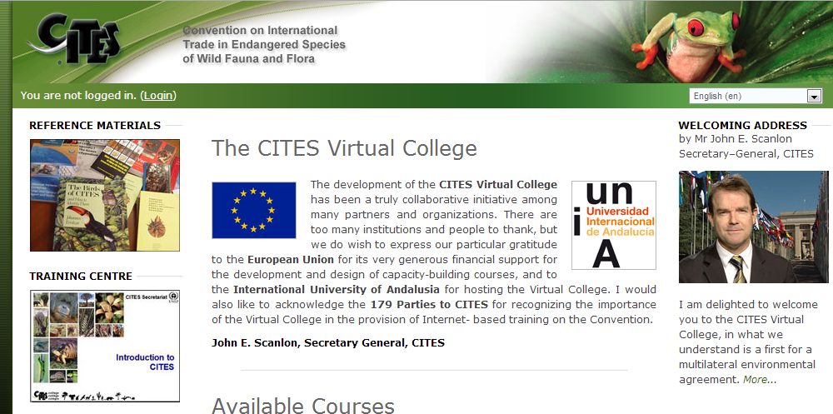
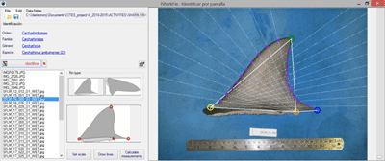
IFS: areas for further work
Capacity building & special requirements of developing States
  Develop tools and materials (e.g. on CITES Virtual College)
  EU-CITES project

Slide 32

Thank you for your attention!
CITES and FAO working for legal, sustainable and traceable international trade in sharks and manta rays, supported by the European Union

